Slide 1

Name:
Arash Harirpoosh
Student Number:
9731505
Presentation Title:
Operation Modes

Slide 2
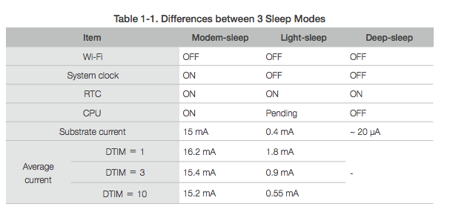
Types of Sleep Modes in ESP8266
Active mode:
Everything will on at all time
whole chip is powered on and can receive and transmit the data
Most inefficient and power consuming mode
Modem-sleep mode:
Default mode for ESP8266
only enabled when it’s connected to an access point
Modem Wi-Fi will be disabled as much as possible

Slide 3
Types of Sleep Modes in ESP8266
Light-sleep mode:
CPU and all peripherals are paused
Any wake-up such as external interrupts will wake up the chip.
Without data transmission, the Wi-Fi Modem can be turned off and CPU suspended to save power consumption
Deep-sleep mode:
Everything is off except Real Time clock (RTC)
Most power efficient option
This mode is useful where the data is transmitted after a long time intervals

Slide 4
References
https://www.losant.com/blog/making-the-esp8266-low-powered-with-deep-sleep
https://circuitdigest.com/microcontroller-projects/esp8266-deep-sleep-mode-programming-explanation

